Slide 1
Web Service
TYBSC (Computer Science)

Slide 2
Distributed Infrastructure
Middleware
Middleware is connectivity software that is designed to help manage the complexity and heterogeneity inherent in distributed systems by building a bridge between different systems thereby enabling communication and transfer of data.

Slide 3
locate applications transparently across the network, thereby providing interaction with another or service
shield software developers from low-level, tedious, and error-prone platform details, such as socket-level network programming
provide a consistent set of higher-level network-oriented abstractions that are much closer to application requirements in order to simplify the development of distributed systems
leverage previous developments and reuse them rather than rebuild them for each usage
provide a wide array of services such as reliability, availability, authentication, and security that are necessary for applications to operate effectively in a distributed environment
scale up in capacity without losing function.

Slide 4
The client–server model
In a client–server architecture, the client actually has two tasks. The client makes requests to servers and is also responsible for the user interface
client–server Internet applications are, by definition, distributed applications.
The client program and the server program interact with each other by sending each other messages over the Internet.

Slide 5
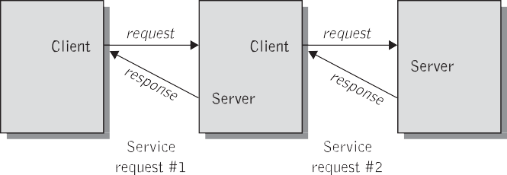

Slide 6
Interprocess communication
Processes on two different end systems (with potentially different operating systems) communicate with each other by exchanging messages across a computer network

Slide 7
Messaging
Distributed systems and applications communicate by exchanging messages.
Messaging is a technology that enables high-speed, asynchronous, program-to-program communication with reliable delivery.
Programs communicate by sending packets of data called messages to each other.
A message typically comprises three basic elements:
Header
Its properties
message payload or body

Slide 8
Header
Destination of a message, the message type, the message
expiration time, and so forth.
properties
contain a set of application-defined name/value pairs.
The message body carries the actual “payload” of the message.
Message passing between a pair of processes is supported by two message communication operations: send and receive
Concept of marshaling and Unmarshaling

Slide 9
Synchronous and asynchronous forms of message communication
basic modes of message communication.
Synchronous or time dependent
Asynchronous or time independent.
Asynchronous messaging, the caller employs a send and forget approach that allows it to continue to execute after it sends the message.
Asynchronous messaging is usually implemented by some queuing mechanism. Two types of message queues exist: these are store and forward and publish/subscribe

Slide 10
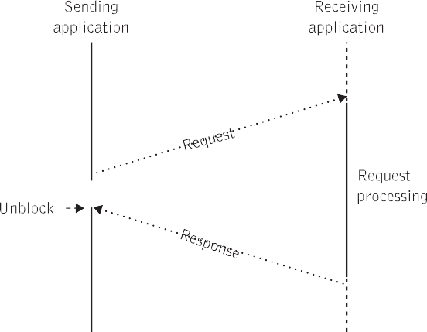

Slide 11
Synchronous forms of middleware
Remote procedure calls
RPC is a basic mechanism for interprogram communication. In effect, RPC is the middle- ware mechanism used to invoke a procedure that is located on a remote system, and the results are returned.

Slide 12
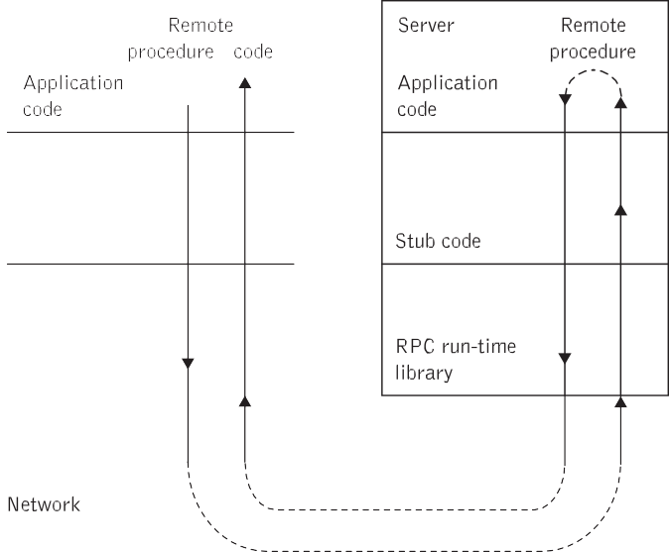
Remote procedure calls
RPC is a basic mechanism for inter program communication. In effect, RPC is the middle- ware mechanism used to invoke a procedure that is located on a remote system, and the results are returned.

Slide 13
Remote method invocation
Traditional RPC systems are language neutral, and therefore cannot provide functionality that is not available on all possible target platforms
The Java RMI provides a simple and direct model for distributed computation with Java objects on the basis of the RPC mechanism.

Slide 14
Asynchronous forms of middleware
Asynchronous communication promotes a loosely coupled environ- ment in which an application does not need to know the intimate details of how to reach and interface with other applications.
Asynchronous communication uses two approaches
Store and forward
Publish/subscribe

Slide 15
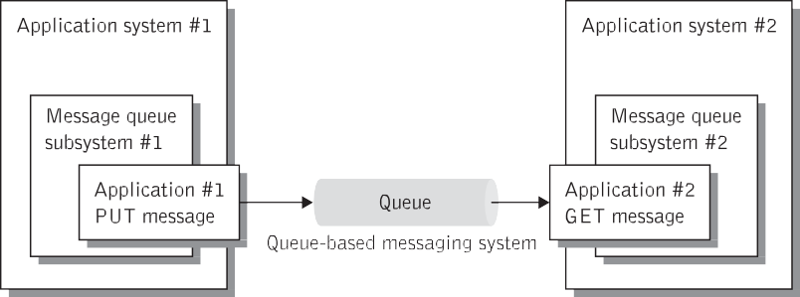
Store and forward messaging
messages are placed on a virtual channel called a message queue by
a sending application and are retrieved by the receiving application as needed
Messages are exchanged through a queue, which is the destination to which senders send messages and a source from which receivers receive messages. The queue is a container that can keep hold of a message until the recipient collects it.

Slide 16
Publish/subscribe messaging
This mode of messaging is a slightly more scalable form of messaging when compared to the store and forward mechanism.
The publish/subscribe messaging works as follows
Publishers publish messages to specific topics.
A message server keeps track of all the messages, and all its currently active and durable subscribers.
As soon as messages are published on a specific topic, they are distributed to all of its subscribers. Durable subscribers, who were not connected at the time of message delivery, can retrieve the messages if they come up within a specified time.
Also Known as push-based model

Slide 17
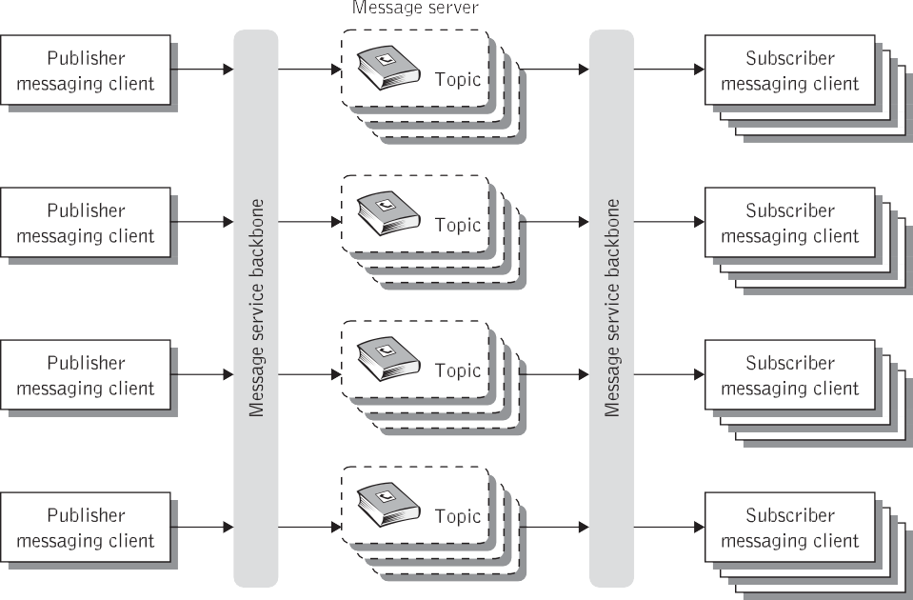

Slide 18
Event-driven processing mechanisms
Point-to-point queuing
Many large systems are divided into several separate units. The point-to-point messaging model allows clients to send and receive messages both synchronously and asynchronously via queues.
Also Known as pull-based or polling- based model.
Messages are requested from a queue instead of being pushed to the client automatically as is the case with publish /subscribe model.
The publish /subscribe approach is based on a push-based model, which means that messages are delivered to consumers without having to request them.
A given queue may be used by multiple receivers, but only a single receiver may consume each message delivered to the queue.
Each message is consumed only once by the next available receiver in a group.

Slide 19
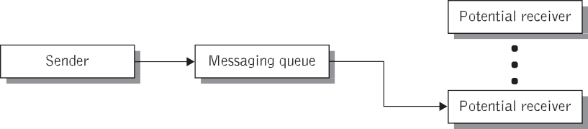

Slide 20
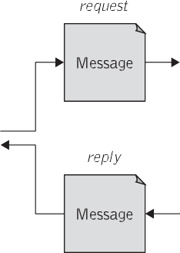
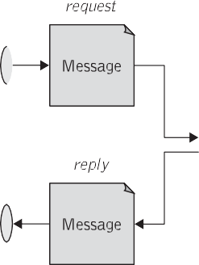


Request/reply messaging
Asynchronous method is fire and Forget

